Slide 1
Authentication
Radha Krishna Gajurel

Slide 2
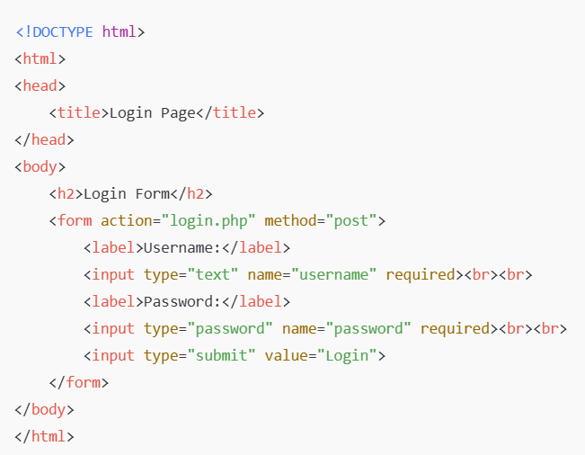
Login.HTML

Slide 3
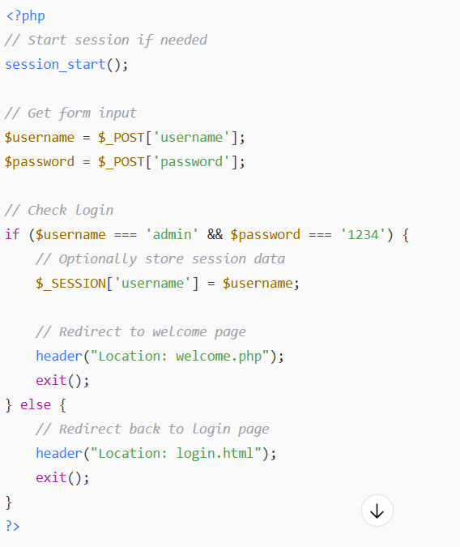
Login.php

Slide 4
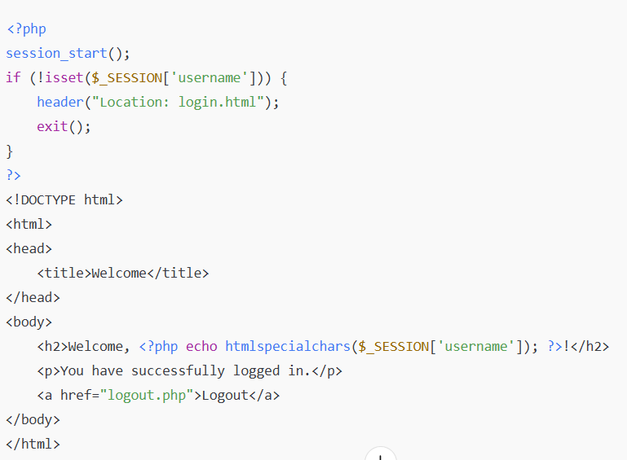
welcome.php

Slide 5
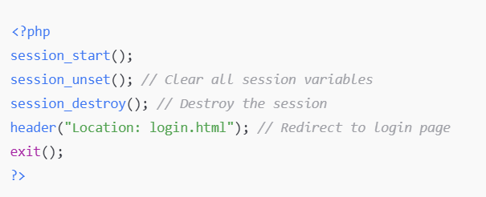
Logout.php

Slide 6
Database connection
MySQL running (via XAMPP/WAMP/etc.)
A database (e.g., mydb) and table (e.g., users) exist

Slide 7
Login.HTML

Slide 8
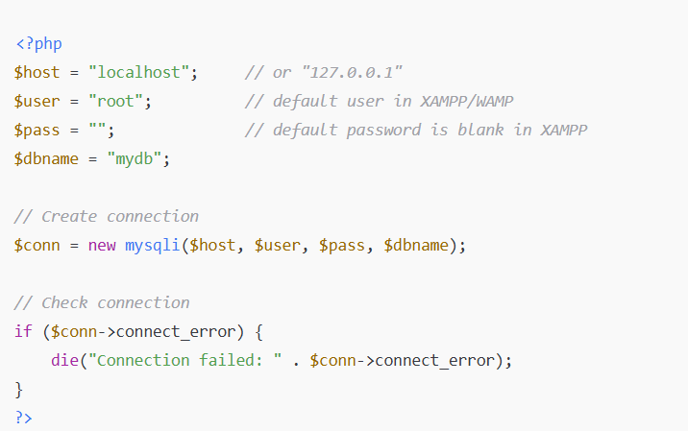
Db.php

Slide 9
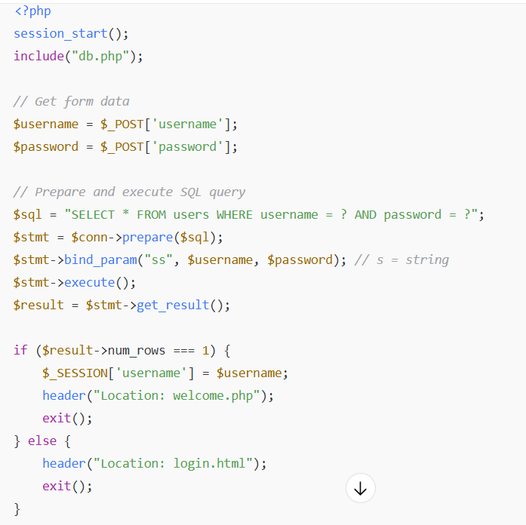
Login.php

Slide 10
welcome.php

Slide 11
Logout.php

